Slide 1
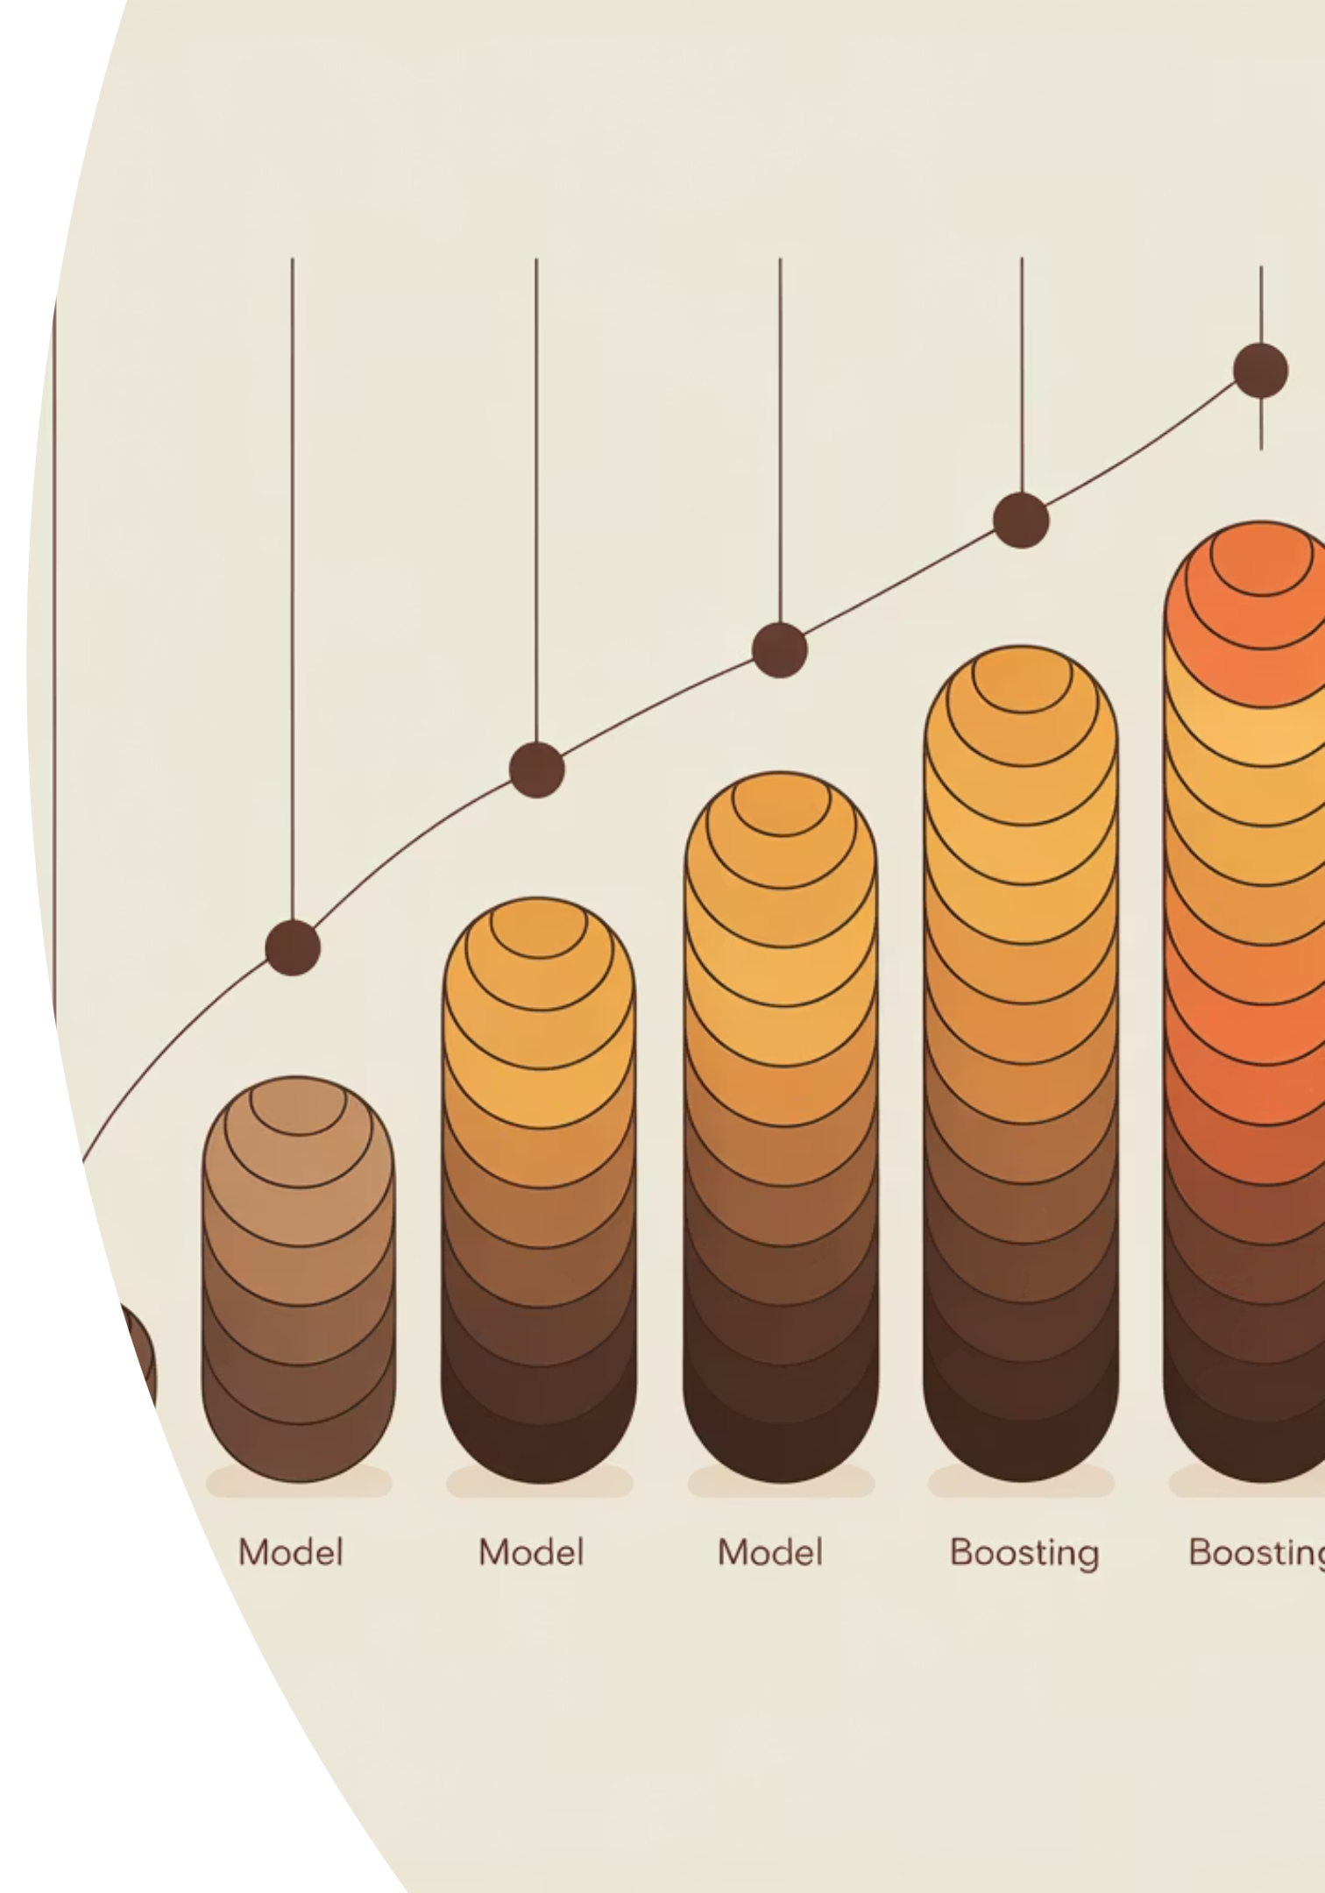
What Is Boosting?
Boosting is a powerful ensemble learning technique that combines multiple simple models into one strong predictor. Models are trained sequentially, with each new model learning from and correcting the errors of its predecessors.

Slide 2
Why Single Models Often Fall Short
The Single-Pass Problem
Think of it this way: Some students repeatedly fail the same exam question. A good teacher doesn't ignore this - they focus extra attention on those challenging concepts. Boosting applies this same principle to machine learning.
When a model sees data only once, it treats all patterns equally. Some patterns are straightforward to learn, while others require more attention and nuance.
A single model may achieve decent overall accuracy but consistently struggle with difficult edge cases - the examples that matter most in real applications.

Slide 3
Weak Learners Are Not Bad
What They Are
Why We Use Them
The Power
A weak learner is a deliberately simple model that is just slightly better than random guessing.
Weak learners are fast to train, resistant to overfitting, and easy to combine. Their simplicity is a feature, not a flaw.
When combined strategically, hundreds of weak learners create a model far stronger than any single complex model could be.
Remember: Weak learners are simple on purpose. Their collective strength comes from intelligent combination, not individual complexity.

Slide 4
The Core Boosting Idea
1
2
Train a Simple Model
Identify Mistakes
Start with a weak learner on your training data. It will make some correct predictions and some mistakes.
Analyze which examples the model got wrong. These are the patterns that need more attention.
3
4
Increase Importance
Train the Next Model
Give more weight to the misclassified examples. The model will now "care" more about getting these right.
Build another weak learner with this new focus. It concentrates on the previously difficult examples.
Core principle: Boosting forces the model to care about hard examples. Mistakes aren't discarded - they become the foundation for improvement.

Slide 5
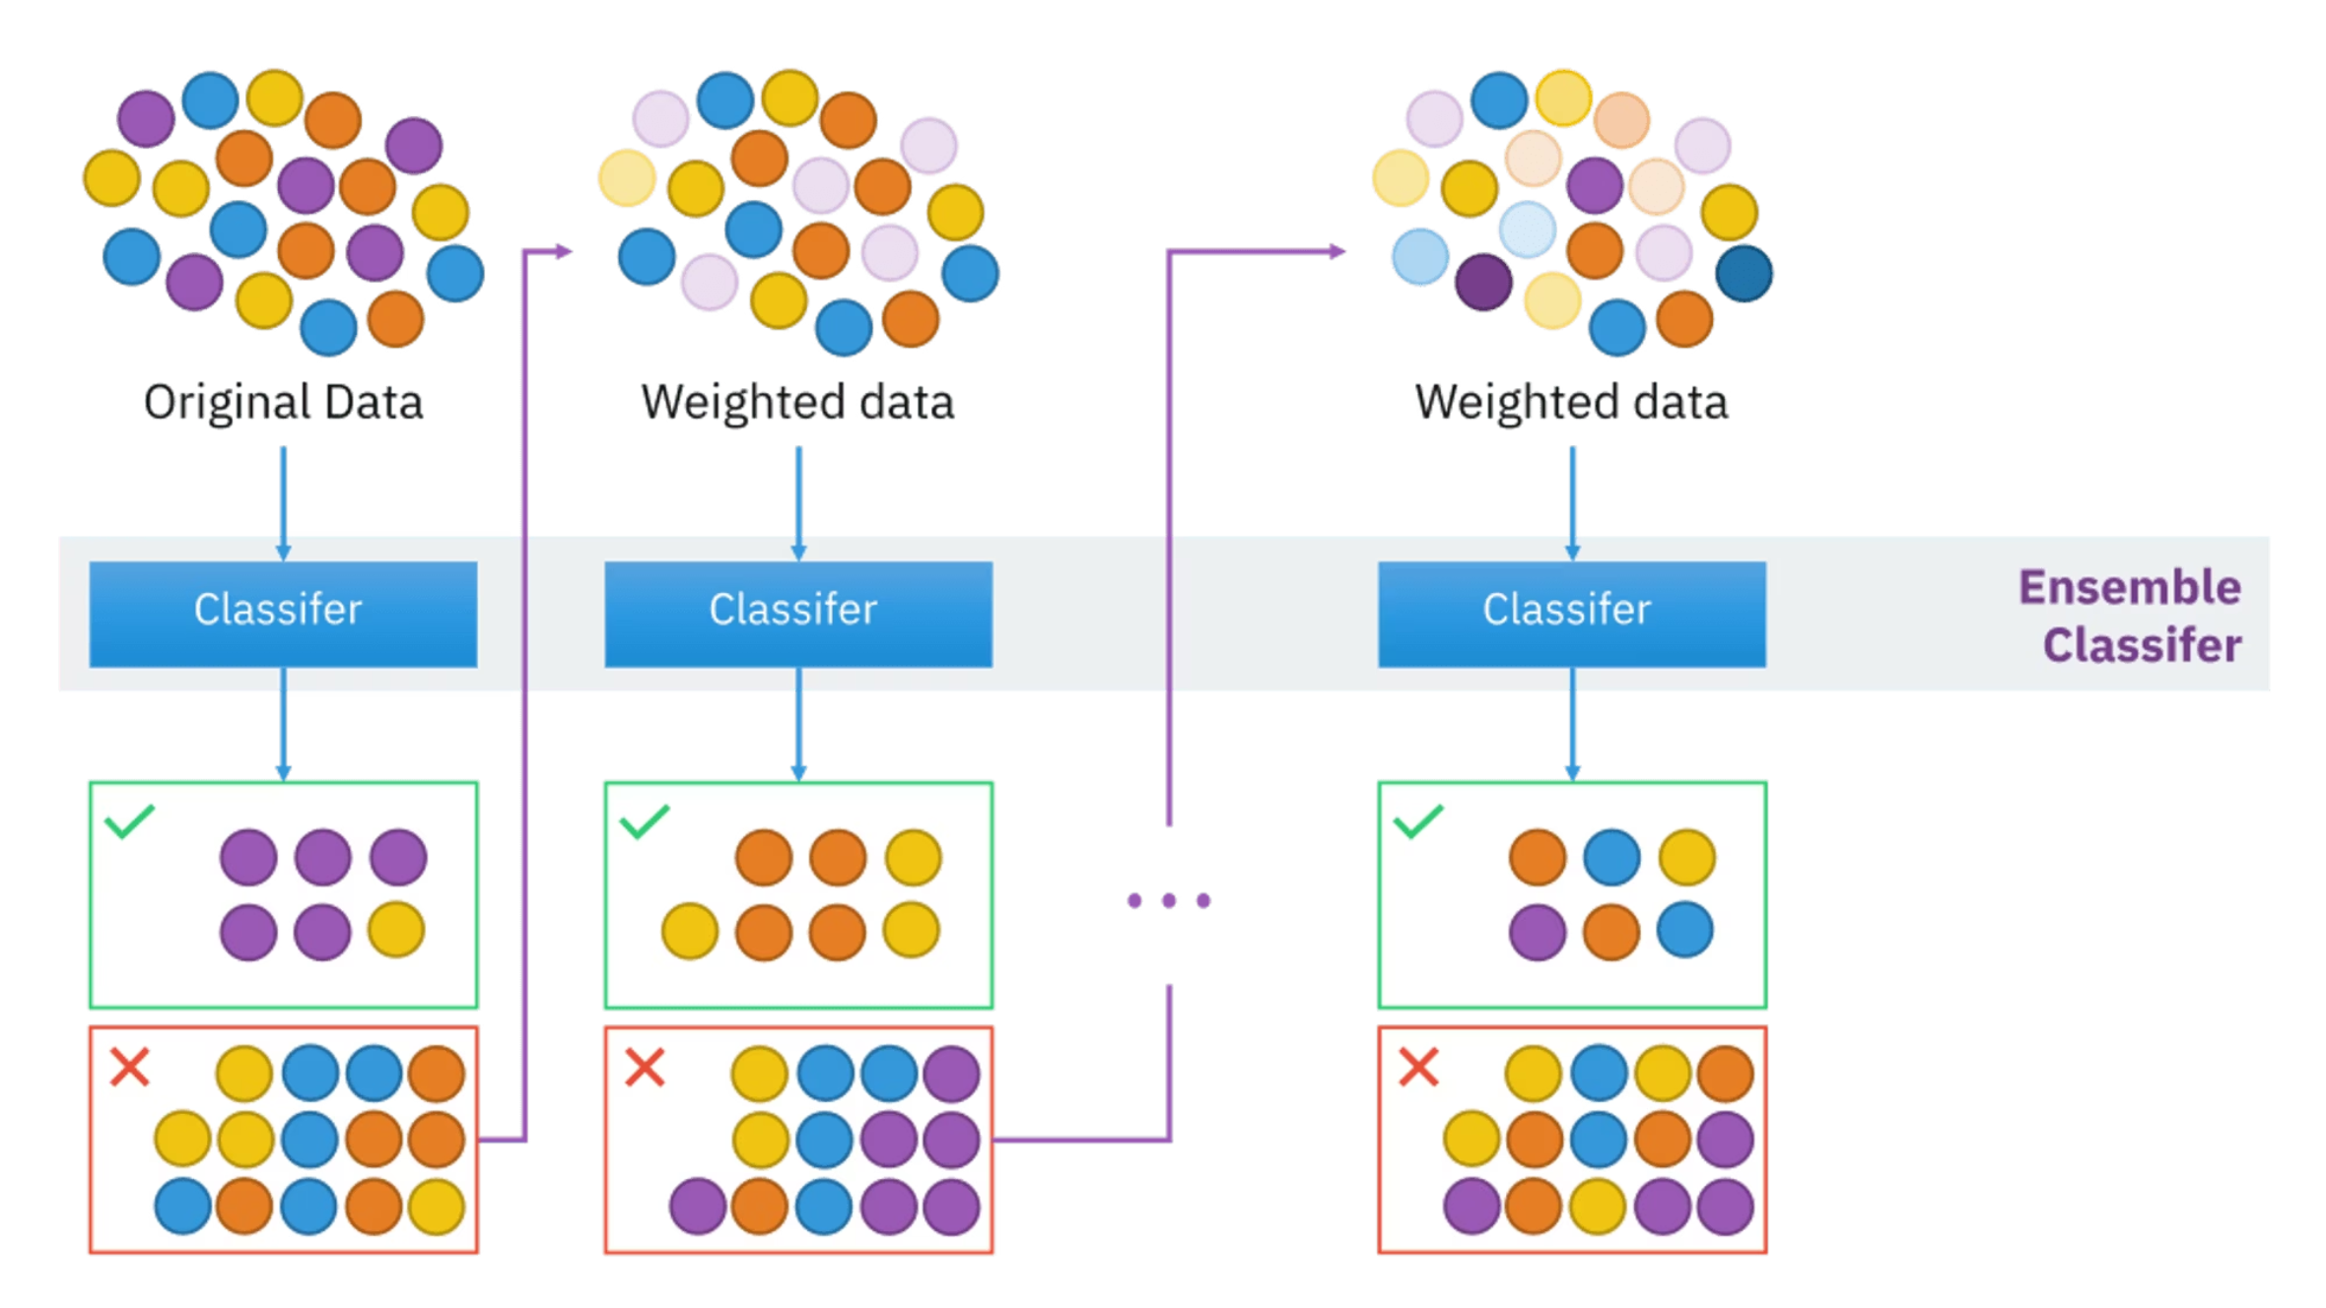
Boosting in Action
This diagram illustrates the sequential nature of boosting. Each model, or "weak learner," is trained in succession, with each new model focusing on correcting the errors made by its predecessors. This iterative process allows the ensemble to progressively refine its predictions, ultimately combining these focused learners to create a single, powerful predictor that achieves high accuracy.

Slide 6
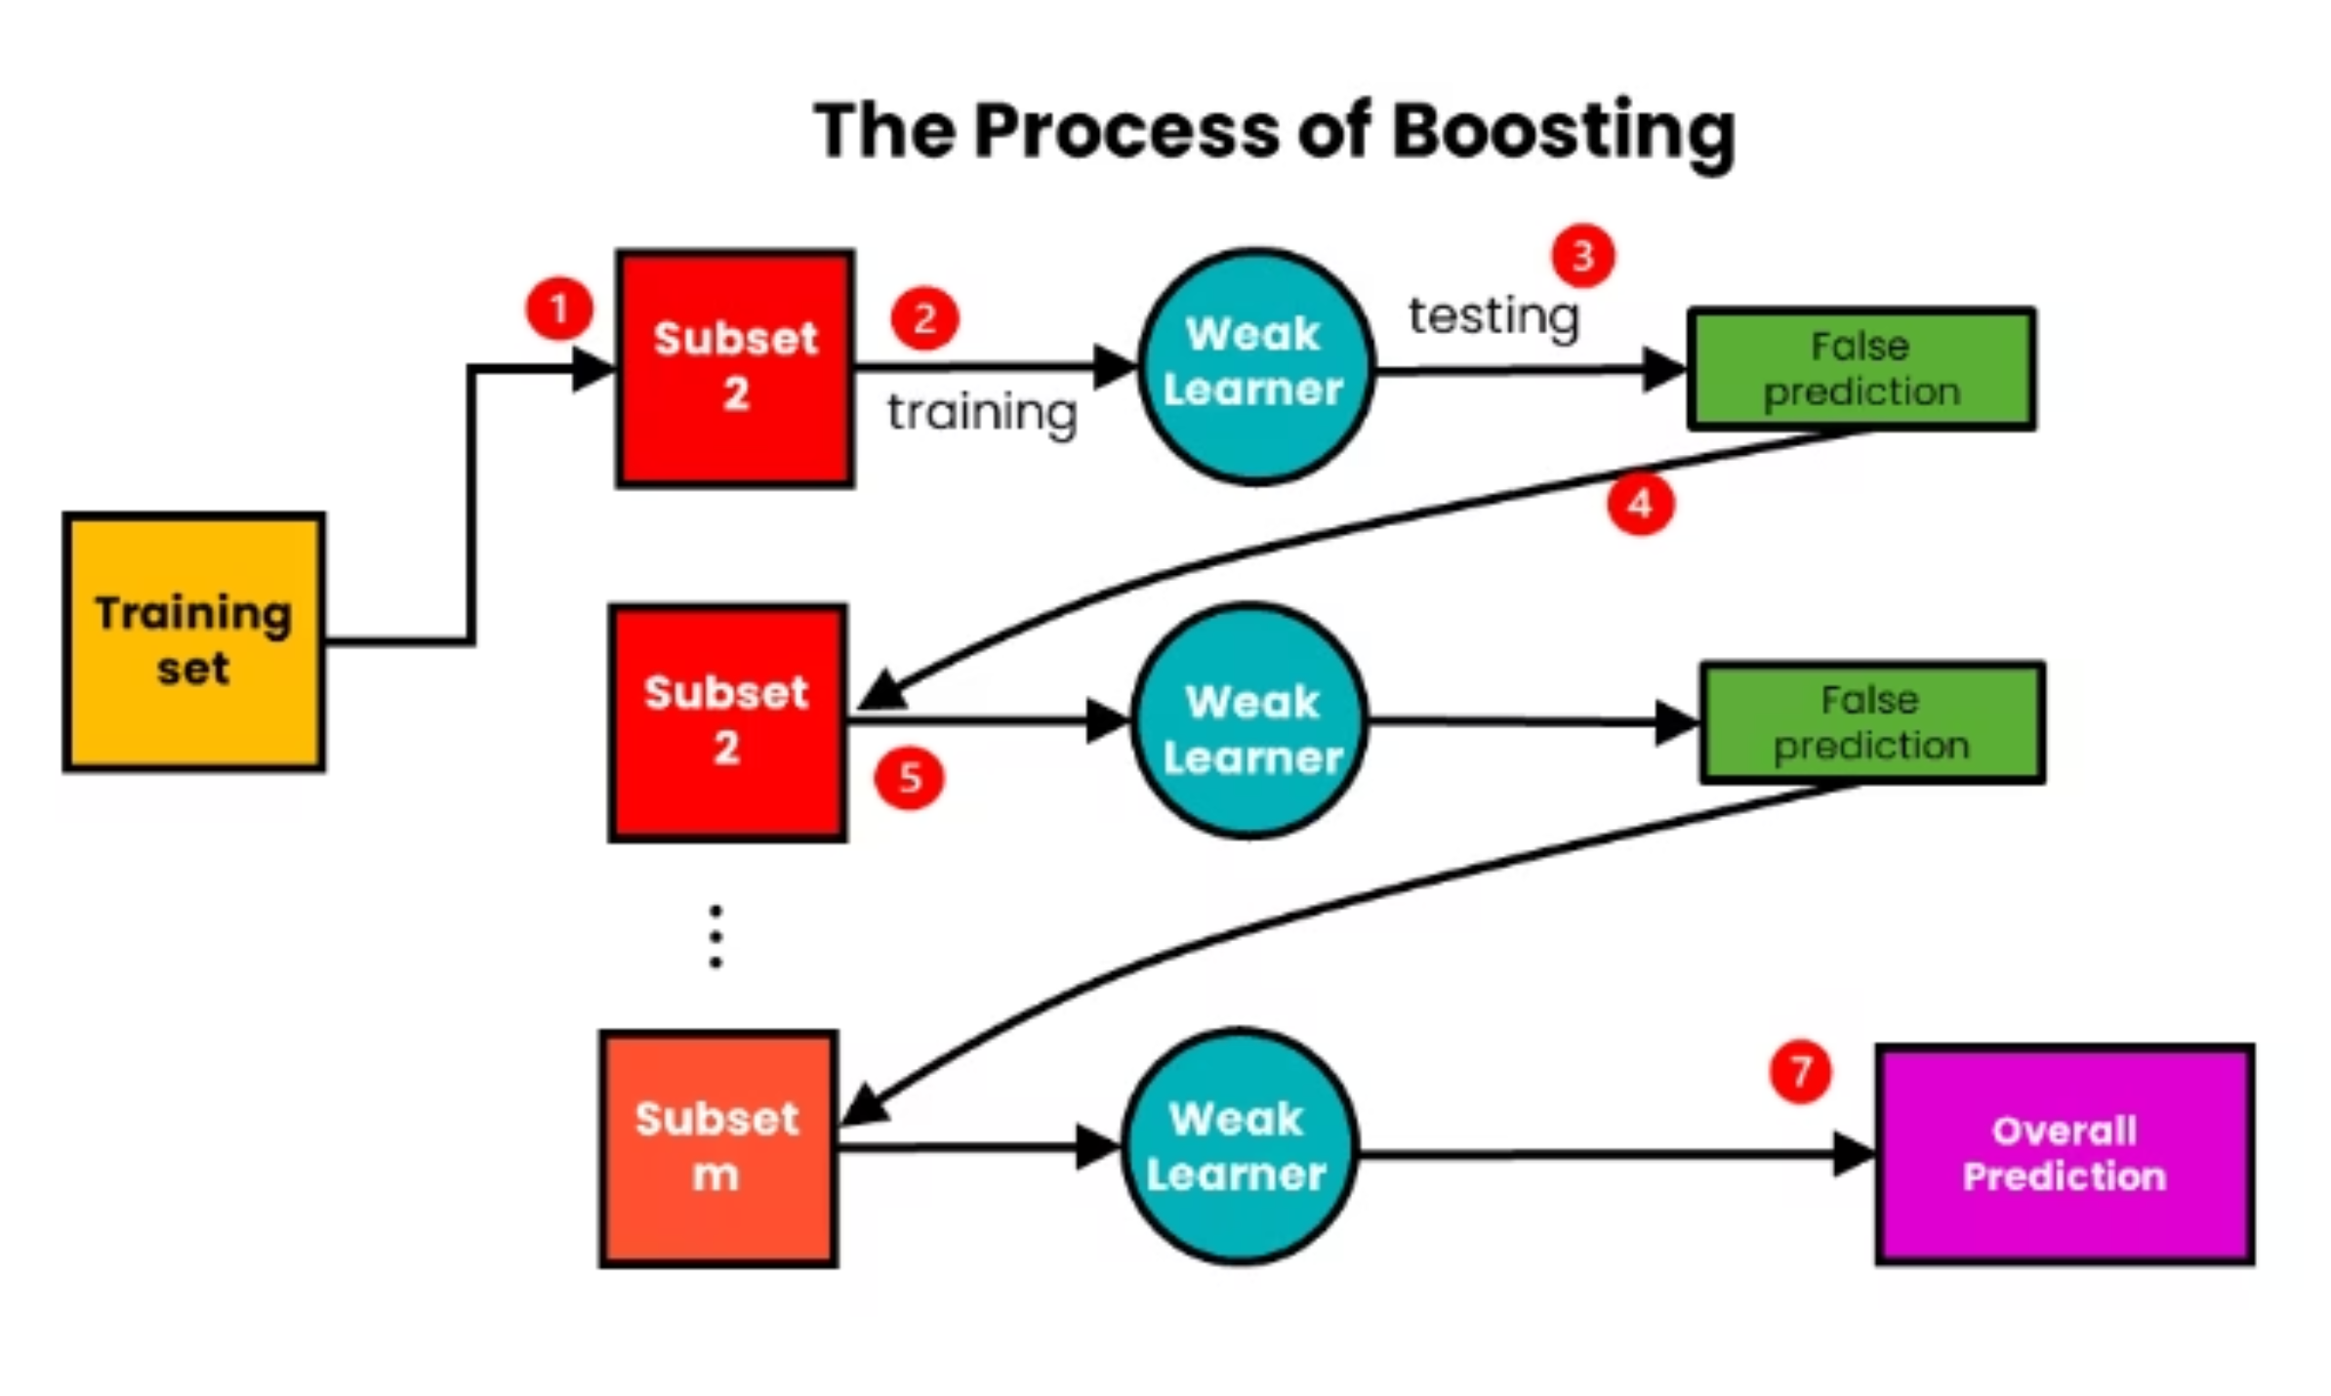
Boosting in Action (Another Example)
This diagram illustrates the boosting process, where multiple weak learners are sequentially trained. Each new model focuses on correcting the errors made by previous models, iteratively refining its predictions. By combining these individual, error-correcting models, boosting builds a powerful final predictor.

Slide 7



Sequential Learning: An Important Difference
Sequential Training
Models are trained one after another in a deliberate sequence. You cannot train them simultaneously.
Dependency Chain
Later models explicitly depend on the performance and errors of earlier models. Each step builds on previous knowledge.
Adaptive Over Time
The learning process adapts dynamically as new information about difficult patterns emerges with each iteration.
This is not parallel learning. The sequential nature is what gives boosting its adaptive power to focus on progressively harder examples.

Slide 8
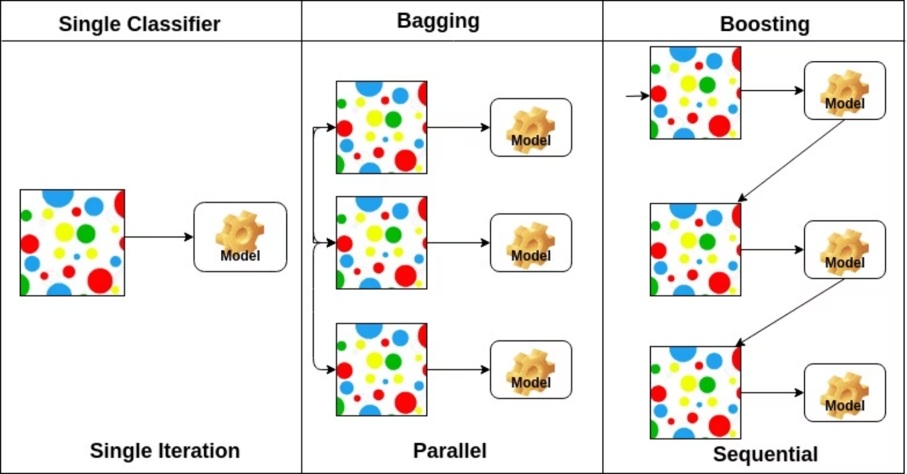
Boosting vs Bagging: A High-Level Comparison
Bagging Approach
Models trained independently and in parallel
Each model sees a random sample of data
Primarily reduces variance
Example: Random Forest
Boosting Approach
Models trained sequentially and adaptively
Each model focuses on previous errors
Primarily reduces bias
Example: AdaBoost, XGBoost

Slide 9



What Boosting Is Trying to Achieve
Focus on Difficult Samples
Improve Step by Step
Build Strength from Weakness
Performance increases incrementally with each model added to the ensemble. Progress is measurable and continuous.
Rather than treating all data points equally, boosting identifies and prioritizes the examples that are hardest to classify correctly.
Transform many weak learners into a single powerful model through strategic combination and weighting.
The boosting philosophy: Mistakes are not ignored or averaged away - they are reused as valuable learning signals to guide the next step of improvement.

Slide 10




Where Boosting Is Commonly Used
Fraud Detection
Medical Diagnosis
Financial institutions use boosting to identify fraudulent transactions by focusing intensively on rare, high-stakes patterns that single models often miss.
Healthcare systems apply boosting to predict diseases and complications, where misclassification of edge cases can have serious consequences.
Credit Risk Prediction
Text Classification
Banks leverage boosting to assess loan default risk, carefully weighing difficult cases that fall between clear approval and denial.
From spam filtering to sentiment analysis, boosting excels at handling nuanced language patterns and ambiguous cases.
Common thread: Boosting works best in domains where mistakes matter - where the cost of misclassification is high and difficult examples require special attention.

Slide 11

Quick Concept Check
1
2
3
Does boosting train models independently?
Does boosting ignore weak learners?
Does boosting focus equally on all samples?
Answer: No. Boosting trains models sequentially, with each model depending on the errors of previous models.
Answer: No. Boosting is built entirely on weak learners, combining many simple models into one strong predictor.
Answer: No. Boosting adaptively increases focus on difficult, misclassified samples with each iteration.
Self-assessment: If you can confidently answer these three questions, you understand the core principles of boosting. You're ready to explore specific algorithms like AdaBoost and XGBoost.

